Slide 1








Daman-Hayat AI
Transforming Prevention
into Profit & Healthspan
Investment Opportunity
$15M (AED 55M)
1,893% ROI • 15,000 Lives Saved

Slide 2



UAE Nationals Live 16 Years in Poor Health
Lifespan
Healthspan
83.3
67.3
16
Top 20 World-wide
Top 20 World-wide
Worldometers 2025
Years of Suffering
Bottom 10 World-wide
WHO 2025
1M+
$5.2B
80%
Thiqa Members at Risk
Annual Healthcare Costs
Chronic Disease is Preventable
The healthspan gap has
widened 45% since 2000
and continues to grow every year

Slide 3

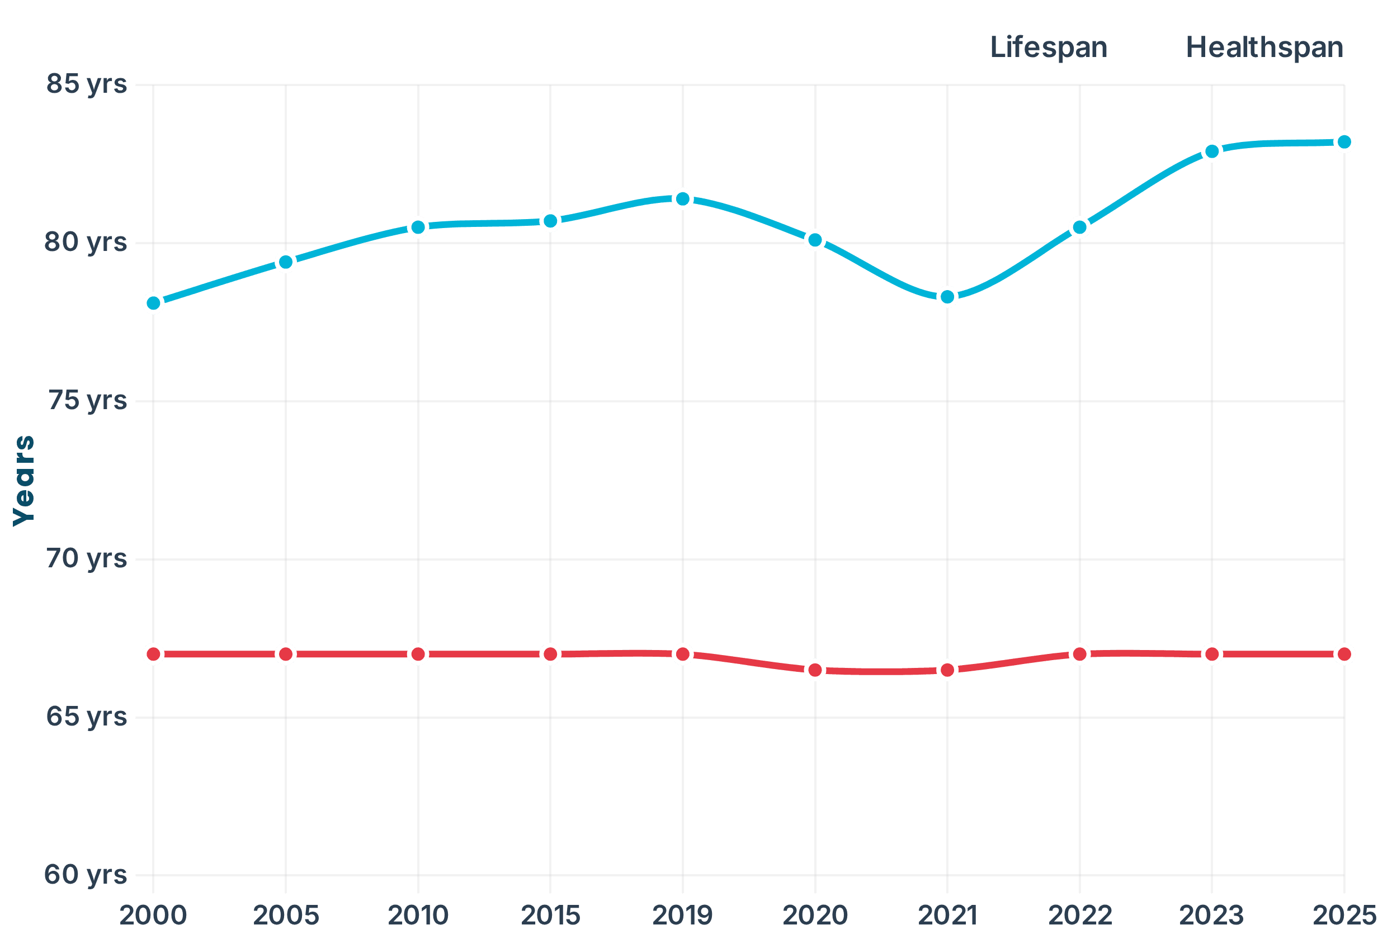
The Healthspan Crisis: Living Longer, But Sicker
UAE Healthspan vs Lifespan Trend (2000-2025)
The Crisis
Medical advances keep us alive longer, but don't keep us healthy longer. Since 2000 the gap has widened 45% from 11 to 16 years—that's 16 years lived with chronic disease, disability, and diminished quality of life.
The Economic Opportunity
Adding 1 year of healthspan = 4-5% of GDP annually
Total UAE
$16-20B/year
Thiqa (1M members)
$1.4-2.2B/year
Hayat AI (15K members)
$200-330M
Source: Nature Aging (2021), NFX (2025)
Source: WHO Global Health Observatory, Worldometers (2025), PMC (2023)

Slide 4

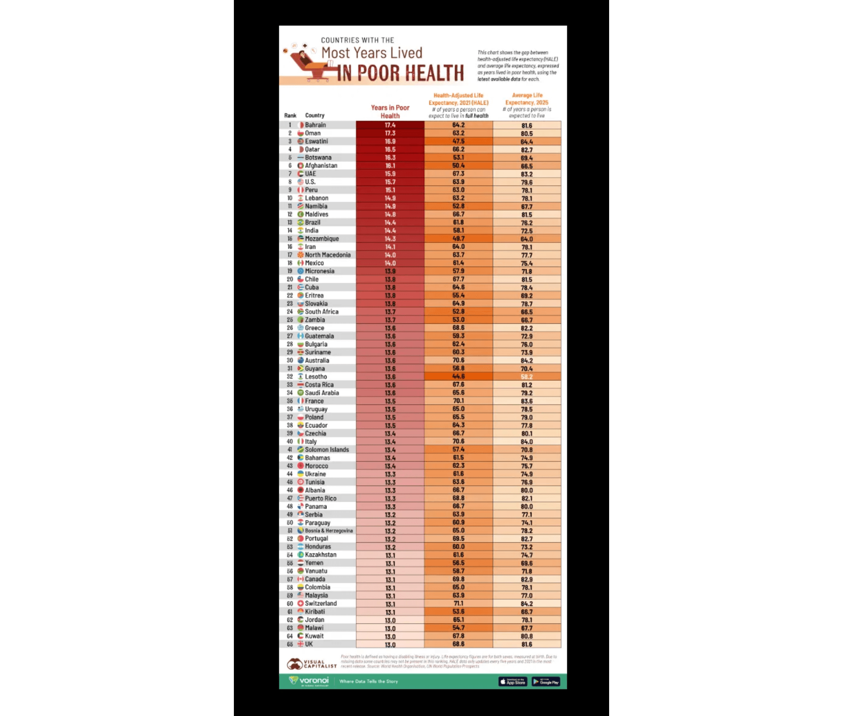
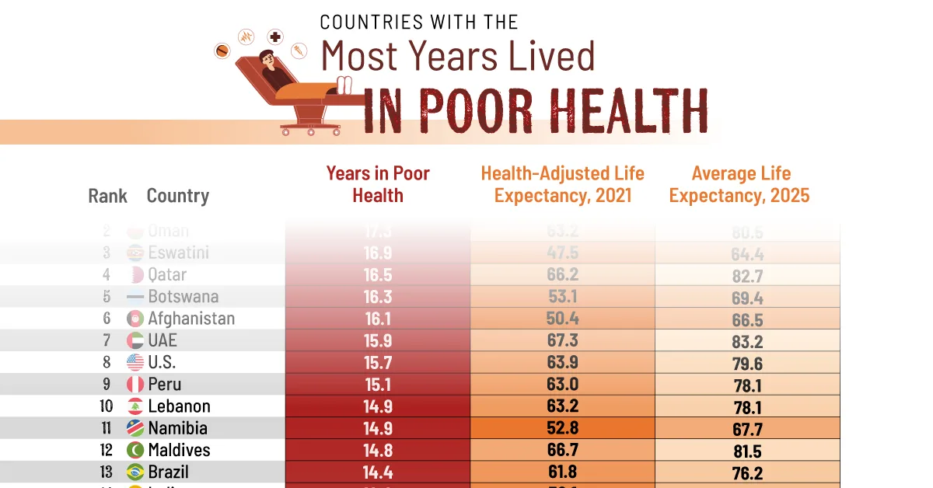
A Crisis: UAE Ranks #7 Worst
Years Lived in Poor Health - International Comparison
UAE ranks #7 globally with 15.9 years lived in poor health (Health-Adjusted Life Expectancy 67.3 years, Life Expectancy 83.2 years). This isn't just a local challenge—it's a crisis where UAE is among the worst performers. The opportunity to improve healthspan is massive, and the urgency is clear.

Slide 5
The Triple Threat: UAE's Preventable Health Crisis
🔴 CVD
🟡 DIABETES
🔵 CANCER
#1 KILLER
EPIDEMIC
RISING THREAT
40%
20.7%
12%
of all deaths
prevalence
(24-25% in nationals)
of all deaths
2x
2.5x
15.4%
cancer rate
global average
young-onset
314/100K
1.27M
5,526
death rate
total cases
new cases/year
80%
90%
10 years
preventable
Type 2 (preventable)
early detection
Detectable: Retinal AI, DEXA, Wearables
Detectable: Blood, Genome, DEXA
Detectable: AI Liquid Biopsy, Genome
Detect: AI Biopsy, Genome | Prevent: Weight, Diet, Exercise
40-50%
COMBINED IMPACT: 52% of all UAE deaths + $11B annual cost
COMBINED IMPACT: 52% of deaths + 60%+ of chronic disease burden + $11B annual cost
preventable (lifestyle)
Sources: American Heart Association (2024), IDF (2024), WHO IARC (2024), UNDP (2024), PMC (2023-2024)
✅ Hayat AI detects and prevents all three simultaneously

Slide 6
Digital Twin Technology—Customized for the UAE
Global Innovation, UAE Customization
🌍
🇦🇪
🎯
PROVEN CONCEPT
UAE-SPECIFIC
TRIPLE THREAT FOCUS
Mount Sinai & leading institutions pioneering Digital Twin for health optimization
• Emirati Genome Database
• CVD
(40% deaths)
• Ramadan-aware protocols
• Diabetes
• Arabic interface
(20.7% prevalence)
We're bringing this proven concept to the UAE—with critical customization
• Cancer
• Halal nutrition guidance
(12% deaths)
• Cultural adaptation
52% of deaths
$11B annual cost
Transforming healthcare from treating illness to improving wellness
No Western platform can match this customization
5-10 year early detection before symptoms
Commercial Platform • Immediate Deployment • Proven PPP Model
Sources: Mount Sinai DigiTwin Project, UAE Genome Database, IDF (2024), UNDP (2024)

Slide 7

The Financial Impact: Year-by-Year
+1 Year Lifespan (Without Healthspan)
+1 Year Healthspan (Closing the Gap)
The Cost of Living Longer, But Sicker
The Value of Living Longer AND Healthier
Thiqa Insurance (Gov Funded)
-$1,900
Healthcare Savings
+$50,000
Direct Healthcare Costs
-$8,200
Productivity Restored
+$16,000
Government Subsidies
-$6,800
Family Burden Removed
+$11,000
Lost Productivity (Patient)
-$12,000
Economic Value Created
+$8,200
Family Caregiver Burden
-$11,000
Minus Healthy Year Cost
-$2,200
Indirect Economic Costs
-$8,200
Total Cost Per Person
-$48,000
Net Value Per Person
+$50,000
Annual Impact on Thiqa Cohort in Gap (35,556 people aged 67-83)
Current Burden: $1.9B/year | Hayat AI Savings Potential: $560M over 5 years
Additionally estimated UAE GDP gain for adding 1 healthy year is $19B
*Based on cohort analysis: 35,556 Thiqa members currently in healthspan-lifespan gap (ages 67-83), with 2,222 new entrants annually. Hayat AI targets 15,000 members, of which ~4,500-6,000 are in relevant age group. Sources: World Bank, WHO, SCAD, PMC research. Nature Aging (2021), NFX (2025)

Slide 8
The Solution: Detection + Monitoring + Prevention
Early Detection
Behavior Change
1
2
Secondary Prevention • Proactive
Primary Prevention • Proactive
AI-powered screening using six data sources detects disease 5-10 years before symptoms.
Mobile app with AI coaching and wearable integration drives sustained lifestyle change.
🩸
Blood Biomarkers
📱
Mobile App
Traditional lab tests for metabolic markers plus optional early cancer screening test
Food tracking, health scores, progress dashboard
🧬
Genome Analysis
🤖
AI Nutritionist
Accelerated access via Thiqa partnership
Personalized meal plans, Emirati cuisine, Ramadan-aware
🏥
Medical Imaging
🎮
Gamification
CT, MRI, ultrasound for structural issues
Real-time wearable feedback • Challenges • Leaderboards
👁️
AI Retinal Screening
Streak tracking • Social competition • Rewards
Google Health AI • Detects diabetes, CVD, stroke risk
👥
Social Engagement
90% cheaper than CT/MRI • Smartphone-based
Community support, family challenges, peer motivation
⌚
Wearable Devices (Optional)
⚠️
Early Warnings and Reminders
Continuous heart rate, SpO2, sleep, activity
Wearable alerts for abnormal vitals • Sleep issues • Inactivity
24/7 monitoring • Early warning alerts
Continuous monitoring • Reminders • Predictive analytics
Impact:
75-95% reduction in late-stage treatment costs
Impact:
Prevent disease from developing in the first place

Slide 9
Multi-Modal Early Detection: Six Data Sources
🩸
🧬
🏥
👁️
⌚
🦴
Blood
Genome
Imaging
AI Retinal
Wearables
DEXA
Key biomarkers
+ Optional Early
Cancer Test
UAE Genome Database access
CT, MRI, ultrasound
for Cancer+ structural issues
Diabetic, Prediabetic
CVD Risk, Stroke Risk
24/7 monitoring
Visceral fat +
bone density
Accelerated Access
$55-140
$270-1,400
$30
Optional
$100-200
AI Retinal Screening
⌚
Wearable Devices
🦴
DEXA Scan
👁️
600K+ screenings globally
Optional • Continuous 24/7 Health Monitoring
Annual Body Composition Screening
Currently Available Sensors:
What It Detects:
What It Detects:
✓ Heart rate (continuous PPG)
✓
Visceral fat
(fat around organs & heart)
✓ Diabetic retinopathy (5-10 years early)
✓ Blood oxygen (SpO2)
✓ Bone mineral density (osteoporosis risk)
✓ Cardiovascular disease risk (heart attack/stroke)
✓ ECG/EKG (single-lead)
✓ Muscle mass distribution
✓ Pre-diabetes (years before diagnosis)
✓ Sleep tracking (stages, quality)
✓ Aortic calcification (CVD risk)
✓ Blood pressure abnormalities
✓ Activity (steps, calories, exercise)
✓ Body composition trends
✓ Stroke risk via vessel patterns
✓ Skin temperature
Why It Matters:
How It Works:
Coming Soon (2026):
•
Hidden danger:
• AI analysis in real-time
⏳ Blood pressure (cuffless, FDA pending)
Most people don't know they have visceral fat
• Quarterly or bi-annual scans
⏳ Sweat biomarkers (cortisol, lactate)
•
Silent killer:
• More accurate than CT/MRI for some conditions
⏳ Hydration status
Visceral fat linked to heart disease, stroke, diabetes

Slide 10



AED 40 Billion Lost Every Year
While preventable diseases steal health, wealth, and happiness from 1M+ UAE nationals
$11B
Total Annual Cost
$5.2B
$5.7B
Healthcare Expenditures
Lost Productivity
UNDP 2024
UNDP 2024
1M+
$3.0B
80%
Thiqa Members Affected
Thiqa Market Size (Est.)
Preventable Through Lifestyle

Slide 11
Multi-Modal Early Detection: Six Data Sources
🩸
🧬
🏥
👁️
⌚
🦴
Blood
Genome
Imaging
AI Retinal
Wearables
DEXA
Metabolic biomarkers
Eraly Cancer Test (Opt)
UAE Genome Database access
CT, MRI, ultrasound for Cancer+ structural issues
Continuous 24/7 monitoring
Visceral fat + bone density
Google Health AI
$55-140
Accelerated Access
$270-1,400
Optional
$100-200
$30
AI Retinal Screening
⌚
Wearable Devices
🦴
DEXA Scan
👁️
600K+ screenings globally
Optional • Continuous 24/7 Health Monitoring
Annual Body Composition Screening
Currently Available Sensors:
What It Detects:
What It Detects:
✓ Heart rate (continuous PPG)
✓
Visceral fat
(fat around organs & heart)
✓ Diabetic retinopathy (5-10 years early)
✓ Blood oxygen (SpO2)
✓ Bone mineral density (osteoporosis risk)
✓ Cardiovascular disease risk (heart attack/stroke)
✓ ECG/EKG (single-lead)
✓ Muscle mass distribution
✓ Pre-diabetes (years before diagnosis)
✓ Sleep tracking (stages, quality)
✓ Aortic calcification (CVD risk)
✓ Blood pressure abnormalities
✓ Activity (steps, calories, exercise)
✓ Body composition trends
✓ Stroke risk via vessel patterns
✓ Skin temperature
Why It Matters:
How It Works:
Coming Soon (2026):
•
Hidden danger:
• AI analysis in real-time
⏳ Blood pressure (cuffless, FDA pending)
Most people don't know they have visceral fat
• Quarterly or bi-annual scans
⏳ Sweat biomarkers (cortisol, lactate)
•
Silent killer:
• More accurate than CT/MRI for some conditions
⏳ Hydration status
Visceral fat linked to heart disease, stroke, diabetes
Cost Advantage:
Gamification Benefits:
Clinical Significance:
$30 vs. $270-1,400 (CT/MRI)
• Real-time feedback & rewards
Gold standard for visceral fat measurement
90-95% cost reduction for comparable insights
• Social challenges & leaderboards
15 min scan • Annual screening • Minimal radiation
Only Platform with 6 Data Sources
Competitors use 1-2 data sources. We combine blood + genome + imaging + retinal + wearables + DEXA for the most comprehensive health picture available.
Google Health Partnership • Multi-Modal AI • Continuous Monitoring • Progress Tracking

Slide 12



We Don't Just Predict Disease—We Prevent It
Early Detection
Behavior Change
PROACTIVE
PROACTIVE
•
AI-powered screening using blood biomarkers
•
Personalized nutrition (Emirati cuisine)
•
Genome analysis with UAE-specific data
•
Gamification and community engagement
•
Advanced medical imaging integration
•
AI health coach with real-time feedback
•
Detects disease 5-10 years before symptoms
•
Cultural adaptation (Ramadan-aware)
•
Accelerated access to 800K+ genome database
•
Prevents disease from developing
Investment
5-Year Return
ROI
Lives Saved
$15M
AED 284M
1,893%
15,000

Slide 13






















The Only Integrated Solution in the Market
Capability
Daman-Hayat AI
Govt AI Platform
Wellness Apps
Precision Med
Early Detection (5-10 years)
Behavior Change & Prevention
Genome Integration
Thiqa Integration
Cultural Adaptation
Gamification & Engagement
Strong Capability
Limited Capability
Not Offered
We are the only platform combining AI early detection with sustained behavior change—purpose-built for the Thiqa population

Slide 14

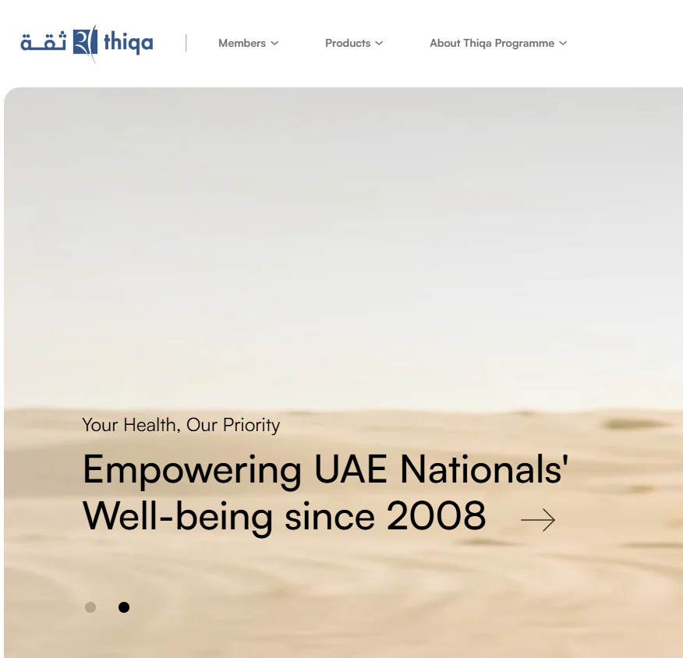


1 Million+ Thiqa Members, $3.0B Market
1M+
$3.0B
Thiqa Members
Market Value (Est.)
100%
2,000+
UAE Nationals Coverage
Hospital Network
Strategic Advantages
Thiqa-Native Platform: Built specifically for 1M+ members with pre-integrated network
Accelerated Data Access: Streamlined access to UAE Genome Database (800K+ genomes)
Government Partnership: Daman backing provides credibility and regulatory pathway
Lower CAC: Thiqa endorsement reduces customer acquisition costs significantly
Market Penetration Strategy
YEAR 1
YEAR 3
YEAR 5
1,000
5,000
15,000
0.1% penetration
0.5% penetration
1.5% penetration

Slide 15





Precision Medicine Trained on Emirati Population
Why UAE-Specific AI Matters
Western Models
Our Emirati-Specific Model
Generic algorithms trained on European and American populations. Completely misses Middle Eastern genetic variations and metabolic patterns.
AI trained on Emirati-specific data. Accounts for regional genetic markers in diabetes, cardiovascular disease, and metabolic disorders unique to the population.
Cultural Adaptation
Population Scale Precision
Emirati cuisine-based nutrition plans, Ramadan-aware health protocols, and family-centered wellness programs that respect local traditions.
Delivering precision medicine for 1 million+ Thiqa members simultaneously, not just individual patients in clinical trials.
Competitors use generic Western models that don't account for Emirati genetics or culture. We deliver precision medicine at population scale powered by UAE-specific data.

Slide 16








UAE Genome Database Integration
800K+
Accelerated
Genomes Sequenced
Data Access via Thiqa Partnership
Specific Applications
Population-specific genetic risk profiling
Emirati metabolic syndrome patterns
Regional diabetes Type 2 markers
Cardiovascular disease variations
Three-Part Precision Medicine Integration
Genetic Predisposition
Current Biomarkers
Lifestyle Integration
Identify inherited disease risks specific to Emirati genetics
Real-time blood analysis and metabolic tracking
Personalized interventions based on combined data

Slide 17





Gamification Drives 3-5x Higher Engagement
80% of chronic disease is preventable through lifestyle changes, but detection without behavior change leads to anxiety without action
AI Nutritionist
Gamification Engine
•
Personalized meal plans based on Emirati cuisine
•
Daily health scores responding to user actions
•
Real-time food tracking with cultural food database
•
Social challenges and community support
•
Ramadan-specific nutrition guidance
•
Rewards and achievement system
•
Genetic + biomarker-based recommendations
•
Leaderboards and friendly competition
Real-Time Feedback
Cultural Integration
•
Biomarker tracking and trend analysis
•
Prayer time-aware activity scheduling
•
Predictive health scores
•
Family-centered wellness programs
•
Personalized intervention recommendations
•
Arabic language with cultural nuances
•
AI coach providing immediate guidance
•
Emirati social norms and traditions
Why This Works
3-5x
40%+
Sustained
Higher Engagement vs Standard Apps
Increased Adherence with Cultural Relevance
Long-Term Motivation Through Community

Slide 18



Proven Public-Private Partnership Model
🇸🇬
Singapore
🇰🇷
South Korea
🇺🇸
US Medicare
2000-2020
2012-Present
2010-Present
National health screening program combining government funding with private sector innovation and delivery.
Population-wide genome project integrated with preventive care delivery through public-private collaboration.
Preventive care coverage expansion through public insurance with private provider network delivery.
Result
Result
Result
15% Reduction in Diabetes
20% Reduction Late-Stage Cancer
$7 Saved per $1 Invested
Our Partnership
UAE Vision 2030 Alignment
Daman
- National Health Insurance
Longevity & Healthy Aging Initiatives
Abu Dhabi DoH
- Regulatory Support
Precision Medicine & Genomics Strategy
Thiqa Network
- 2,000+ Hospitals
Economic Diversification Beyond Oil

Slide 19

1,893% ROI in Optimal Scenario
Investment Required: $15M ($15M)
Optimal Scenario
Realistic Scenario
Worst Case
1,893%
927%
360%
Return on Investment
Return on Investment
Return on Investment
5-Year Return
5-Year Return
5-Year Return
AED 284M
AED 180M
AED 90M
Net Profit
Net Profit
Net Profit
AED 229M
AED 125M
AED 35M
Members Served
Members Served
Members Served
15,000
10,000
5,000
Market Penetration
Market Penetration
Market Penetration
1.5%
1.0%
0.5%
Even in the worst case scenario, investors more than triple their investment while transforming preventive health for thousands of UAE nationals

Slide 20

Strong Unit Economics: 37.8x LTV/CAC
Lifetime Value
÷
Acquisition Cost
=
LTV/CAC Ratio
AED 18,900
AED 500
37.8x
Payback Period: 3.3 months | Break-even: Month 18
70%
20%
10%
Thiqa Partnership
Direct-to-Consumer
Data Licensing
Primary Revenue
Secondary Revenue
Future Revenue
•
Per-member-per-month (PMPM): AED 150
•
Premium features: AED 99/month
•
Anonymized health insights to researchers
•
Outcome-based bonuses for health improvements
•
Advanced genetic insights
•
Pharma partnerships for clinical trials
•
Personalized coaching
•
Population health analytics
•
Cost savings sharing with Thiqa
AED 150
5 Years
2.1x
80%+
Monthly Revenue per Member
Average Member Lifetime
Revenue Multiplier
Annual Retention Rate

Slide 21

5-Year Path to 15,000 Members
Year 1
Year 2
Year 3
Year 4
Year 5
Foundation
Validation
Growth
Expansion
Scale
1,000
3,000
5,000
10,000
15,000
Members
Members
Members
Members
Members
Key Milestones
Key Milestones
Key Milestones
Key Milestones
Key Milestones
•
Platform development
•
Expand to 2,000 members
•
Scale to 5,000 members
•
Double to 10,000 members
•
Reach 15,000 Thiqa members
•
Thiqa integration
•
Reach 3,000 by year-end
•
Launch D2C tier
•
Expand to Dubai, Sharjah
•
Presence in 3 GCC countries
•
Pilot launch 500 beta users
•
Refine AI models
•
Begin data licensing
•
International pilot (KSA, Qatar)
•
AED 284M revenue (optimal)
•
Scale to 1,000 members
•
Demonstrate biomarker improvements
•
Achieve profitability
•
Regional market leader
•
Prepare Series B funding
•
Validate unit economics
•
15%+ health outcomes
•
80%+ retention rate
•
Regional health leader
•
Prove 30%+ engagement
Building
Validating
Profitable
Expanding
Market Leader
Key Success Metrics
30%+
15%+
80%+
50+
Engagement Rate
Biomarker Improvement
Annual Retention
NPS Score

Slide 22

$15M Investment Allocation
Total Investment: $15M ($15M)
Technology & AI Development
30%
AED 16.5M
AI model development and training • Platform engineering and infrastructure • Genome database integration • Mobile app development (iOS/Android) • Cloud infrastructure and security
Clinical Operations & Partnerships
25%
AED 13.75M
Thiqa integration and partnership management • Clinical validation studies • Hospital network integration • Medical advisory board • Regulatory compliance
Marketing & Customer Acquisition
20%
AED 11M
Brand development and positioning • Digital marketing campaigns • Community engagement programs • Sales team and partnerships • Customer success operations
Operations & Overhead
15%
AED 8.25M
Team salaries and benefits • Office space and facilities • Legal and professional services • Insurance and risk management • Administrative costs
Contingency & Reserve
10%
AED 5.5M
Unexpected regulatory requirements • Market condition changes • Technology pivots • Extended runway if needed
Burn Rate Timeline
Year 1
Year 2
Year 3
Year 4-5
Profitability
AED 20M
AED 18M
AED 12M
Self-Sustaining
Year 3

Slide 23






The Investment Decision
Massive Market Opportunity
Proven Business Model
Unique Competitive Position
Exceptional Returns
Impact Beyond Returns
The Investment Opportunity
Investment
5-Year Return
ROI
Lives Saved
$15M
AED 284M
1,893%
15,000
This is not just an investment—it's a chance to reshape the future of health for an entire nation while achieving exceptional financial returns
Next Steps
1
Due Diligence & Financial Review
2
Meet Daman/Thiqa Partnership Team
3
Review Technology & AI Capabilities
4
Finalize Investment Terms
5
Launch Q1 2026

Slide 24
HAYAT HEALTH SCORE: Measuring Your Healthspan
One Comprehensive Score + Six Actionable Pillars (Blueprint-Optimized)
HAYAT HEALTH SCORE
0-100
😴 Sleep & Recovery
25%
🫀 Cardiovascular
25%
🩸 Metabolic Health
20%
🧠 Cognitive Health
10%
😊 Mental Health
10%
🦠 Microbiome
10%
Based on Bryan Johnson's Blueprint Protocol • Predicts Health 12-18 Months Ahead • UAE-Customized

